Slide 1



Golden Thread Advocacy Programme
Advocacy under the Social Services & Well-being (Wales) Act 2014

Slide 2

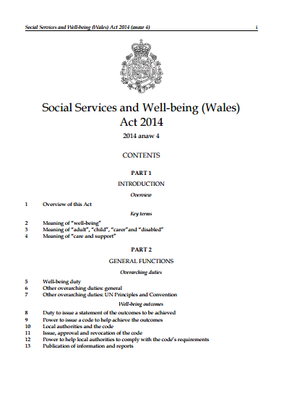
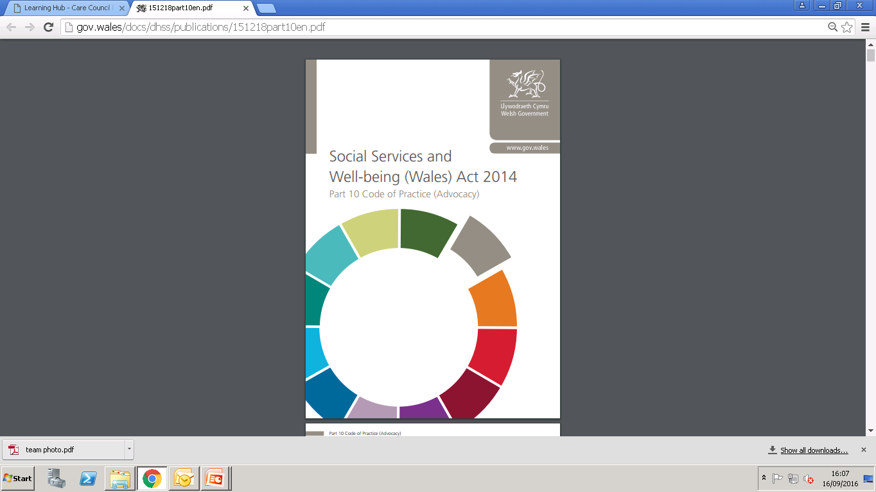
The Act & Code
Notes:
The Social Services and Well-being (Wales) Wales Act 2015 came into force on the 6th April 2016 and it will have a big impact on the types of Local Authority services that are delivered and how they are delivered in Wales. Part 10 of the Act sets out the new legal provisions on advocacy. It states that in certain circumstances, local authorities must ensure that an individual has access to advocacy.
The Act sets out the bare bones; the details are fleshed out in a statutory Code of Practice. It’s on the WG website and on the Care Council for Wales website. Chapter 20 of the Code of Practice relates to advocacy. The CoP states that "Advocacy services are fundamental to supporting people to engage actively and participate in the development of their own well-being outcomes“.

Slide 3

What is advocacy?
  27. Advocacy is one of several forms of support available for people who need assistance in working through life issues.

Slide 4

What is advocacy?
“The link between information, advice and advocacy resembles interrelated circles, in which each links to the other. Rather than being different points along the same continuum, information, advice and advocacy may best be described as circles of support.”
- Information, advice and advocacy for older people,
Andrew Dunning, Joseph Rowntree Foundation, 2005

Slide 5


What is advocacy?
Advocacy
Information
Assistance
Befriending
Advice

Slide 6
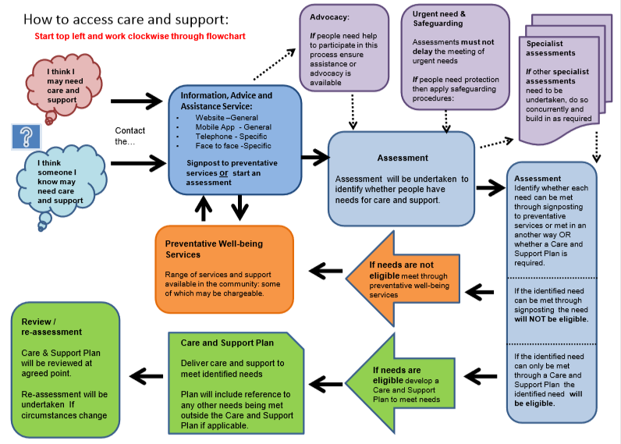

Slide 7
What is advocacy?
Advocacy is taking action to help people say what they want, secure their rights, represent their interests and obtain the services they need.
Advocates and advocacy schemes work in partnership with the people they support and take their side.
Advocacy promotes social inclusion, equality and social justice.
- Advocacy Charter, Action for Advocacy (2002)

Slide 8
What is advocacy?
Independent advocacy supports the person regardless of the demands and concerns of others. It challenges the causes and effects of injustice, oppression and abuse, and upholds human rights.
- OPAAL National Forum (2008)

Slide 9

What is advocacy?
Fundamentally, advocacy is concerned with supporting people to express their views, wishes and feelings, in contrast to the role of most other professionals who are primarily concerned with promoting individuals’ best interests.

Slide 10
Advocacy is NOT about: χ making decisions for the client χ pressurising or persuading someone to take a course of action without having a mandate to do so χ giving medical, legal or benefits advice χ befriending χ counselling χ acting in someone’s best interests

Slide 11

Patricia is a 15 year old young carer who looks after her Mum, who has early stage dementia. Both need help from social services. They also need support to participate as fully as possible in their assessments. Patricia is referred to a children & young people’s advocacy service, and her Mum to adults advocacy.

Slide 12
The advocates get to know their clients and provide as much information as they can to them about health and social services processes, and about the options available to them.

Slide 13
The advocates also help their clients to be clear about the outcomes that they want for themselves from the services to be provided. They help them identify any barriers they might have to participating fully in the assessment, care and support planning, review and, if necessary, safeguarding processes.

Slide 14
The advocates attend the assessment meetings and support their clients to speak up for themselves and express their views, wishes and feelings, or represent them when appropriate.
They help their clients to feel equal partners with the professionals and in control of what’s happening so that their care and support plans say what they want them to say.

Slide 15
The advocates take their client’s side and help them to stand up for their rights and challenge decisions or make complaints if necessary.
The advocates are always concerned with enabling their clients to advocate for themselves as far as possible.

Slide 16
Advocacy Video
Dewis Centre for Independent Living and the National Youth Advocacy Service (NYAS) produced a video about advocacy for the Gwent Safeguarding Board:
http://bit.ly/AdvocacyVid

Slide 17
Requirements of the
Part 10 Code of Practice
7. This code sets out the requirements for local authorities to:-
a) ensure that access to advocacy services and support is available to enable individuals to engage and participate when local authorities are exercising statutory duties in relation to them and
b) to arrange an independent professional advocate to facilitate the involvement of individuals in certain circumstances.

Slide 18
Requirements of the
Part 10 Code of Practice
31. Advocacy can take many forms, each with the common aim of supporting individuals to have their voices heard, clarify their options and express their views, wishes and feelings. Each form of advocacy has its own benefits and local authorities should recognise and value all these forms.

Slide 19
Requirements of the
Part 10 Code of Practice
32. Professionals will need to be alert to situations where they believe that the objectivity or independence of the decision making process is, or could be seen to be undermined. In such circumstances, the roles of other forms of advocacy must be considered.
43. Advocacy includes the full range of provision set out in Chapter 8.

Slide 20
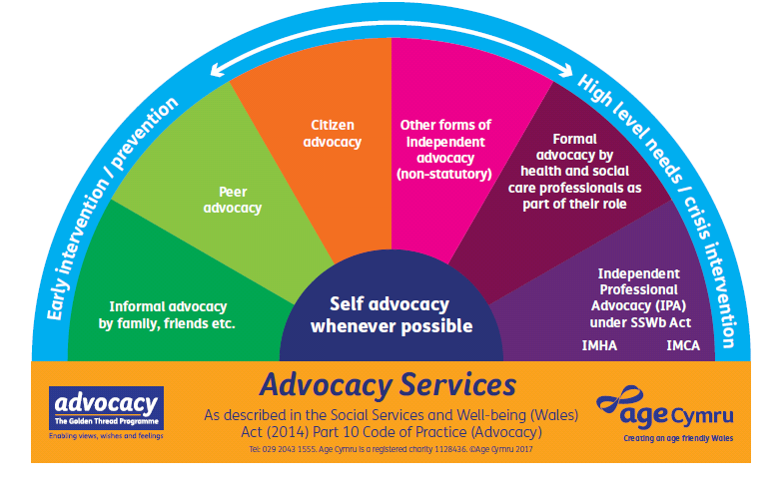
The spectrum of advocacy

Slide 21

Self-Advocacy
Advocates of all kinds are always concerned with helping people to advocate for themselves as far as possible.
Self-Advocacy Rules!

Slide 22
What is Independent Professional Advocacy?
Chapter 8
Independent Professional Advocacy - involves a one-to-one partnership between an individual and an advocate who is trained and paid to undertake their professional role as an advocate...
for purposes relating to their care and support.

Slide 23
What is Independent
Professional Advocacy?
Part 10 Code of Practice (Advocacy)
Annex 1:
The role of the independent professional advocate.
Annex 2:
The local authority role in supporting the advocate.

Slide 24
When must local authorities arrange provision of Independent Professional Advocacy?
47. Local authorities must arrange for provision of an independent professional advocate when a person can only overcome the barrier(s) to participating fully in the assessment, care and support planning, review and safeguarding processes with assistance from an appropriate individual, but there is no appropriate individual available.

Slide 25
What does “participating fully” mean?
48. Participating fully enables the individual to express or have represented and taken into account their views, wishes and feelings; (and to) understand their rights and entitlements; the decision making process; what matters to them; the personal well-being outcomes that they wish to achieve; the barriers to achieving those outcomes, and the options and choices available to them.

Slide 26
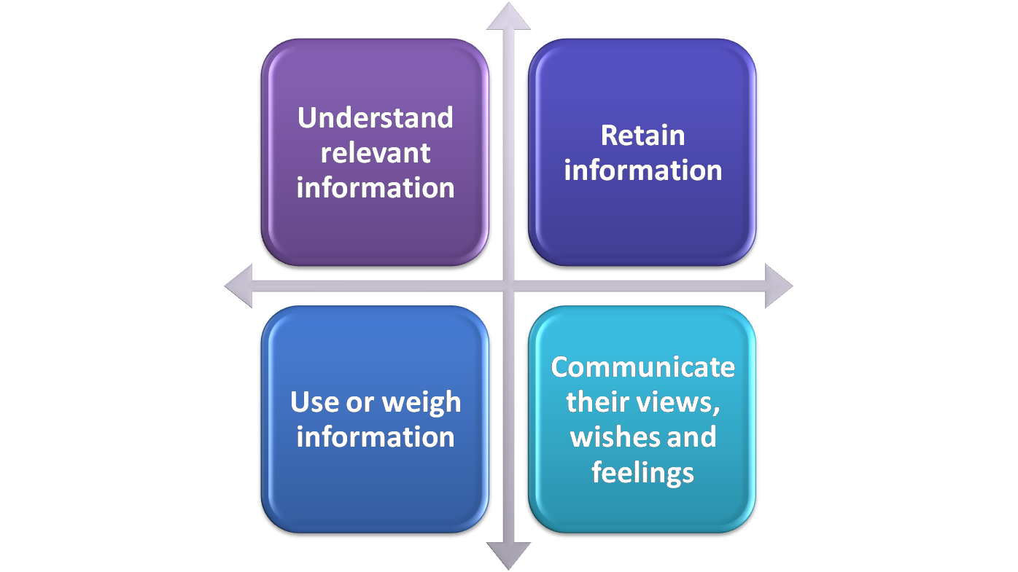
What are “barriers to participating fully”?
55. Key barriers will include issues
and situations that will impair individuals’ ability to:

Slide 27
Who can be an
“appropriate individual”?
An appropriate individual is someone who can facilitate a person’s involvement in the assessment, care planning, review and safeguarding processes, but cannot be someone who:
  the person does not want to support them
  is unlikely to be able to, or available to, adequately support them, or
  is implicated in a safeguarding enquiry.

Slide 28
Summary
LAs must arrange provision of IPA when a judgement has been reached in partnership with an individual that they:
need care and support from social services but
  have difficulty with understanding, retaining, using or weighing relevant information, or
  communicating their views, wishes and feelings,
      and there is no appropriate individual or other form of advocacy available to support or represent them.

Slide 29
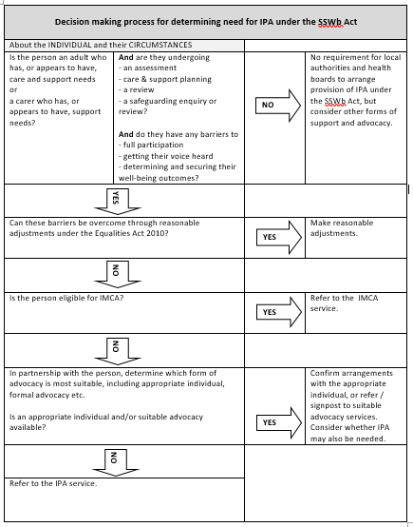
Determining need for IPA

Slide 30
What does the Part 10 Code mean for commissioners?
Must arrange provision of Independent Professional Advocacy for people in certain circumstances
All forms of advocacy should be recognised and valued
Must consider the role of other forms of advocacy when there’s an actual or potential conflict of interest
New services with no new funding

Slide 31
What does the Part 10 Code mean for providers?
In future providers of Independent Professional Advocacy may be regulated under RISCA
Quality Performance Mark as a minimum requirement
Professionalisation, training & qualifications
Capacity to meet demand
Tender readiness

Slide 32
What does the Part 10 Code mean for providers?
Opportunity - threat
Funding - loss of funding
Certainty - uncertainty
Expand - contract
Hope - fear
Clarity - confusion

Slide 33


What does the Part 10 Code mean for everyone?
Culture change
Co-production
Creative commissioning

Slide 34
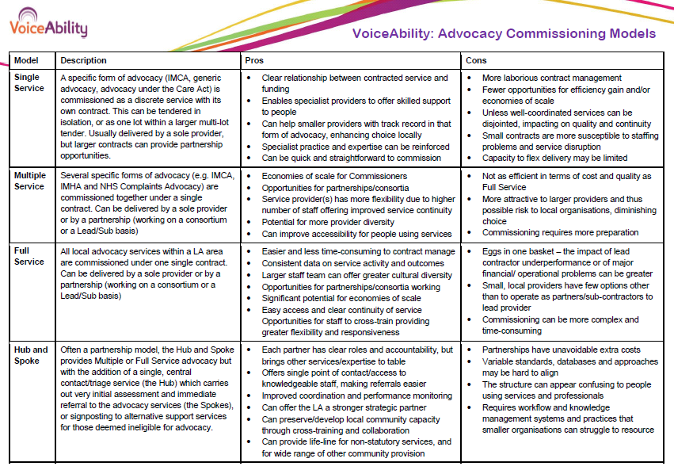
Service models

Slide 35

Why Co-production?
.

Slide 36
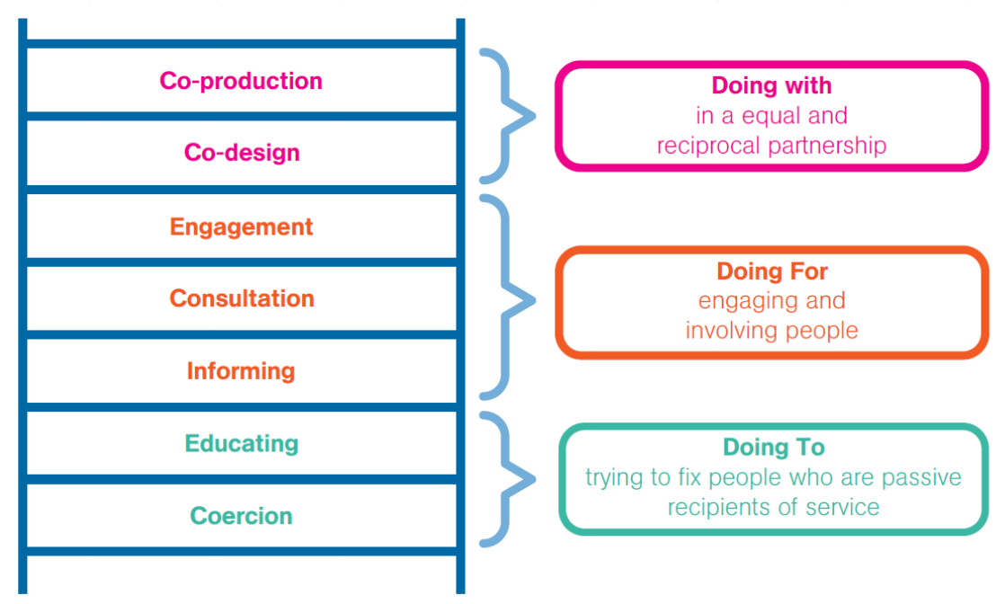
Levels of engagement

Slide 37
What is co-production?
Co-production enables
citizens and professionals to
share power and responsibility,
and to work together
in equal partnerships.

Slide 38
What is co-production?
Co-production enables people who receive services to work with professionals to design, create and deliver services.
It means being equal partners and co-creators, which distinguishes it from “participation”.

Slide 39
What is co-production?
Co-production should be understood as including:
co-design i.e. the planning and design of services
co-decision making in the allocation of resources
co-delivery of services, including the role of volunteers in providing services
co-evaluation of services.

Slide 40
What is co-production?
The key features of co-production include:
Recognising and valuing all participants as assets with skills, knowledge and experience to contribute
Building trust through shared power and responsibility
Removing the barriers between professionals and citizens
Recognising that people who receive services are experts

Slide 41
What is co-production?
Building upon individuals’ existing strengths and capabilities
Developing networks of mutual support
Prioritising what matters for the people involved
Ensuring that people receive something back for putting something in
Building on people’s desire to feel needed and valued.

Slide 42
What is co-production?
The core principles of co-production include:
  Equality
  Diversity
  Inclusion
  Accessibility
For further information about Co-production visit: http://bit.ly/SCIEcopro

